Slide 1



MOTION PREDICTION
- COMPARATIVE STUDY &
INTRODUCING A NEW MODEL
SYED ALI HAIDER | HARSH TAMBI | SPRING 2024 | COMPUTER VISION

Slide 2

PROBLEM UNDERSTANDING
AGENT (CYCLISITS, PEDESTRIANS ETC.
ROAD MAPS
TREES, BUSHES, TRAFFIC LIGHTS, POTHOLES ETC.
SYED ALI HAIDER | HARSH TAMBI | SPRING 2024 | COMPUTER VISION

Slide 3


DATASETS
WAYMO
NVIDIA
SYED ALI HAIDER | HARSH TAMBI | SPRING 2024 | COMPUTER VISION

Slide 4
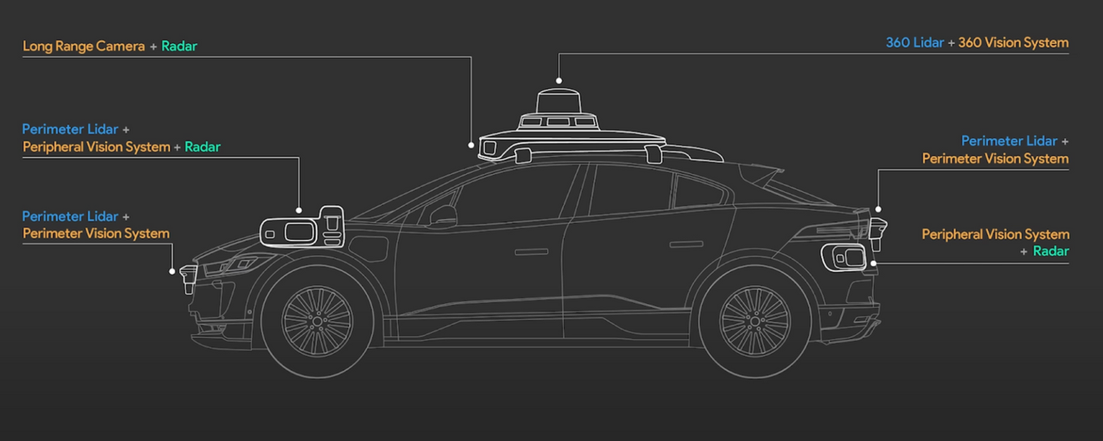
DATASETS
WAYMO
SYED ALI HAIDER | HARSH TAMBI | SPRING 2024 | COMPUTER VISION
Notes:
The dataset includes data captured by a variety of sensors mounted on Waymo's vehicles, including
LiDAR sensors provide 3D point cloud data, which captures the vehicle's surroundings in detail, including the positions and shapes of objects.
Cameras capture high-resolution images of the environment, providing visual context for the surrounding scene.
Radar sensors measure the relative velocities and distances of objects, complementing the data from LiDAR and cameras.
The dataset is annotated with ground truth labels for various objects in the scene, including
other vehicles
pedestrians
cyclists,
traffic signs
road markings.
it's easier for algorithms to understand what's going on in different driving situations.

Slide 5
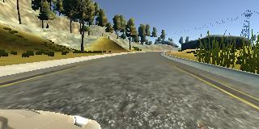
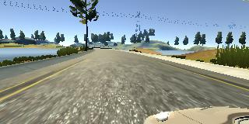
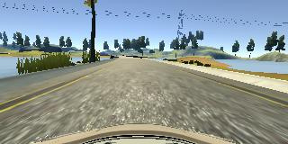
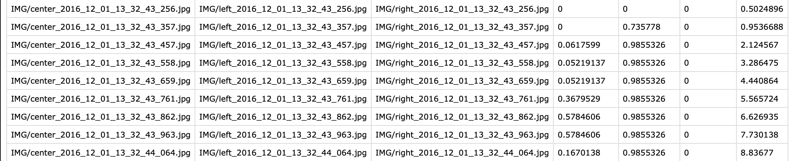
DATASETS
NVIDIA
SYED ALI HAIDER | HARSH TAMBI | SPRING 2024 | COMPUTER VISION
Notes:
This dataset was released by NVIDIA Driving AI Labs, and would be used in DAVE-2 approach which we'll talk about in the next few slides.
The training data for the autonomous driving system was gathered from diverse road types and weather conditions across central New Jersey and several other states. It included various road types like two-lane roads, residential streets, tunnels, and unpaved roads, and weather conditions ranging from clear to snowy. Data collection utilized a car cameras in similar positions and had images from the (right, left, and centre camera), and a csv file recording the steering wheel angle of the car.

Slide 6
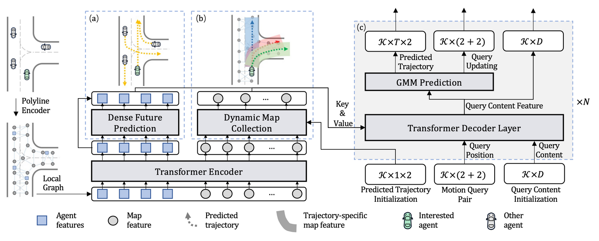
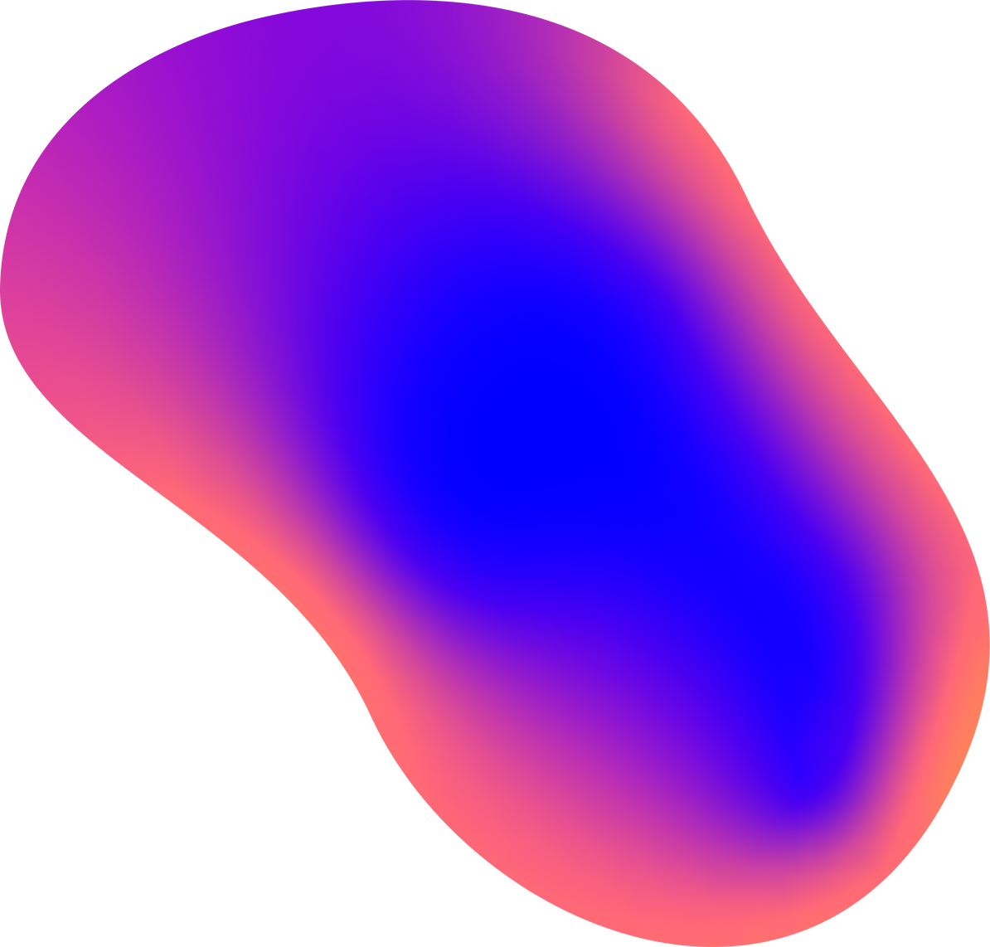
MTR
MOTION TRANSFORMERS
Data
Polylines
3D Points
Motion query pairs
Static intention query
Dynamic searching query
Encoding Scene Context
Localized Attention Mechanisms
Trajectory Prediction and Refinement
SYED ALI HAIDER | HARSH TAMBI | SPRING 2024 | COMPUTER VISION
Notes:
Polylines → Maps
3D Point Clouds → Environmental Features
# Motion query pairs
- The **static intention query** -> helps figure out the general goals or intentions of each car, like where they might be headed in the long term.
- The **dynamic searching query** constantly scanning the surroundings, picking up details about how cars are moving right now.
Motion Forecasting History:
1. Static
2. Dynamic
Encoding Scene Context
- This encoder processes input trajectories and road maps, encoding them into feature representations while preserving the crucial local structure through local self-attention mechanisms, like nearby lanes and intersections.
Localized Attention Mechanisms
- Imagine you're looking at a crowded street. There's a lot going on, with cars moving in different directions and people crossing the road. Now, instead of trying to see everything at once, you can use a spotlight to focus on one area at a time. This spotlight helps you pay attention to the cars closest to you or the pedestrians crossing the street, while ignoring the rest of the scene. This helps the model make more accurate predictions by paying attention to the details that matter most in the current context
Trajectory Prediction and Refinement
Future trajectories and velocities of all agents are densely predicted using a regression head on past agent data. Subsequently, the decoder network refines predicted trajectories using "motion query pairs," aiding in localizing potential motion intentions and refining local movement information.
GMM
Cars can move in different ways, creating uncertainty in predictions.
Using Multilayer Perceptron (MLP) to predict parameters of different movement patterns.
GMM helps represent all possible ways the car could move.

Slide 7
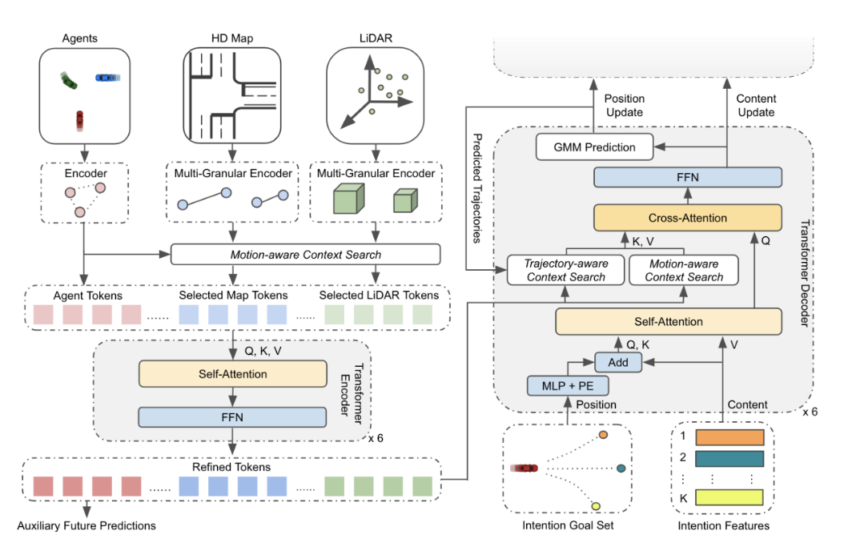
MGTR
Multi Granular Context Encoder
Implementation of LIDAR for
the first time
Achieved SOTA performance
Inspired by MTR
SYED ALI HAIDER | HARSH TAMBI | SPRING 2024 | COMPUTER VISION
Notes:
The authors of this study have developed a novel approach for motion prediction by incorporating multi-granular context encoding into a transformer-based framework. Drawing inspiration from MTR's research, they have leveraged newly added LIDAR data from the Waymo Open Dataset challenge to enhance their approach. Their primary motivation stems from the belief that single-granular context encoding is insufficient, leading them to explore various forms of agent representations such as maps and point clouds for better predictions. By integrating LIDAR data, they aimed to capture regions overlooked by traditional mapping methods, enriching the context provided to their transformer model.
Their model accepts multimodal inputs including agents, HD maps, and LIDAR, encoding them at multiple granularities. A motion-aware context search mechanism selects meaningful context for agents, followed by a self-attention layer and a feed-forward network for motion prediction. In the decoder, inspired by MTR, they utilize a cross-attention layer to aggregate tokens and employ a Gaussian Mixture Model to represent trajectories, thereby generating predictions for the involved agents.

Slide 8
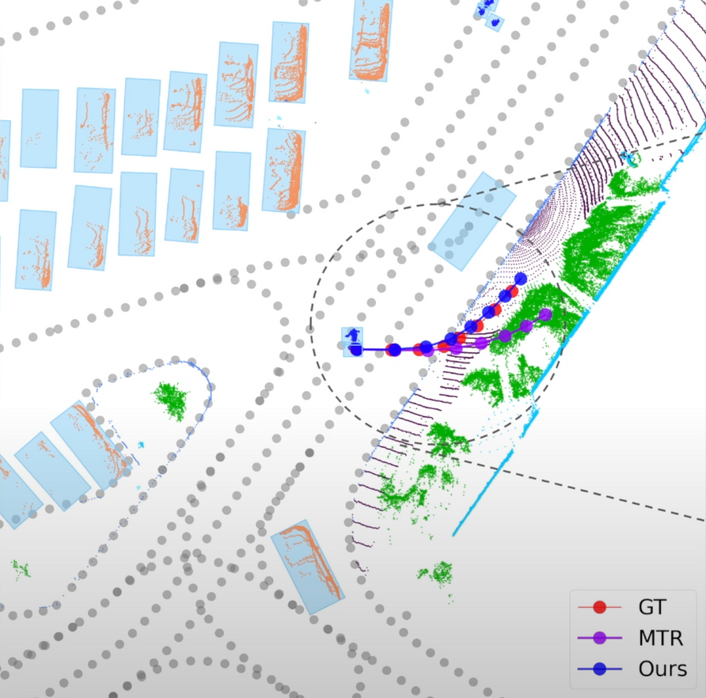
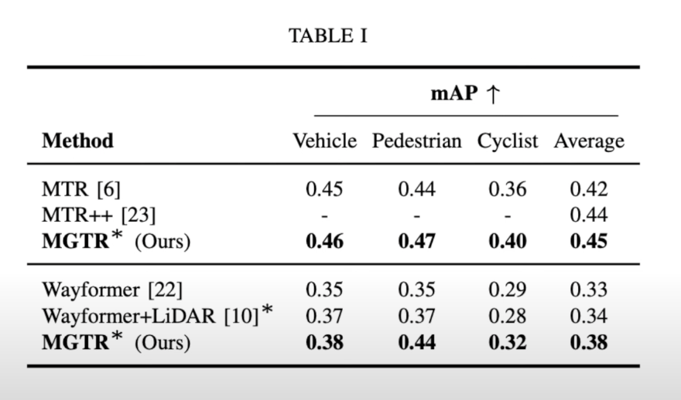
Comparison of MGTR and MTR
Notes:
Performance analysis of the proposed approach, Multi-Granular Transformer for Motion Prediction (MGTR), compared to the previous model, Motion Transformer (MTR), was conducted and published by the authors, with results accessible online through Waymo's dataset. The results indicate that MGTR outperformed MTR in terms of the Mean Average Precision (MaP) metric across all agent types present in the dataset: cyclists, pedestrians, and vehicles. Additionally, the average MaP achieved by MGTR was higher.
A specific example highlighting the effectiveness of MGTR over MTR is illustrated through a graph, demonstrating a pedestrian's future trajectory prediction. In this example, while MTR predicts the pedestrian moving into bushes, MGTR, with its multi-granularity approach incorporating LIDAR and point cloud encodings, accurately predicts the pedestrian's motion trajectory, placing them on the sidewalk closer to the actual ground truth value. This basically showcases the superior predictive capability of MGTR in capturing nuanced agent behaviors and environmental contexts, leading to more accurate motion predictions.

Slide 9
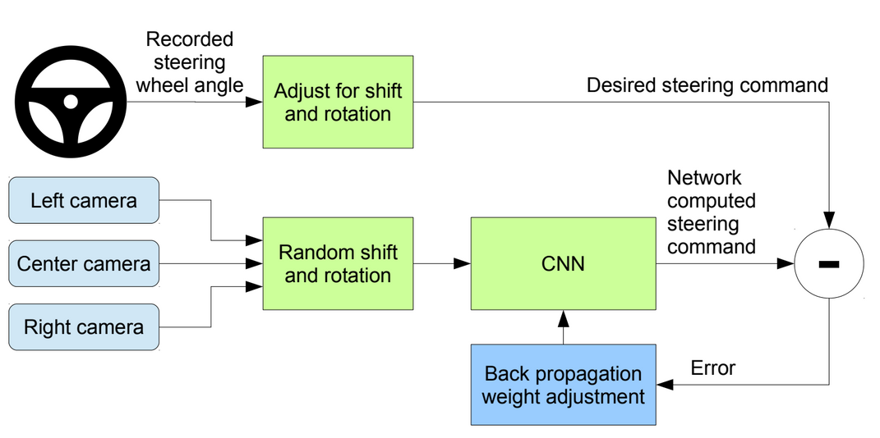
DAVE 2
SIMPLE CNN BASED APPROACH
Model Design
Convolutional Neural Network (CNN)
Convolutional layers for feature extraction
Fully connected layers for prediction.
Input
Timestamped Video paired with steering command, from 3 angles
Output
Autonomous Steering Commands
SYED ALI HAIDER | HARSH TAMBI | SPRING 2024 | COMPUTER VISION
Notes:
# Dave 2
- including 5 convolutional and 3 fully connected layers.
1. **Forward Pass**:
- During training, each video frame is fed into the CNN, and computations are performed layer by layer to generate predictions for the steering angle.
- The predicted steering angle is compared to the actual steering angle from the dataset to compute the loss, which measures the difference between the predicted and desired outputs.
2. **Backpropagation**:
- The loss is propagated backward through the network using backpropagation.
3. **Parameter Update**:
- The gradients are used to update the parameters of the network in the opposite direction of the gradient, aiming to minimize the loss.

Slide 10
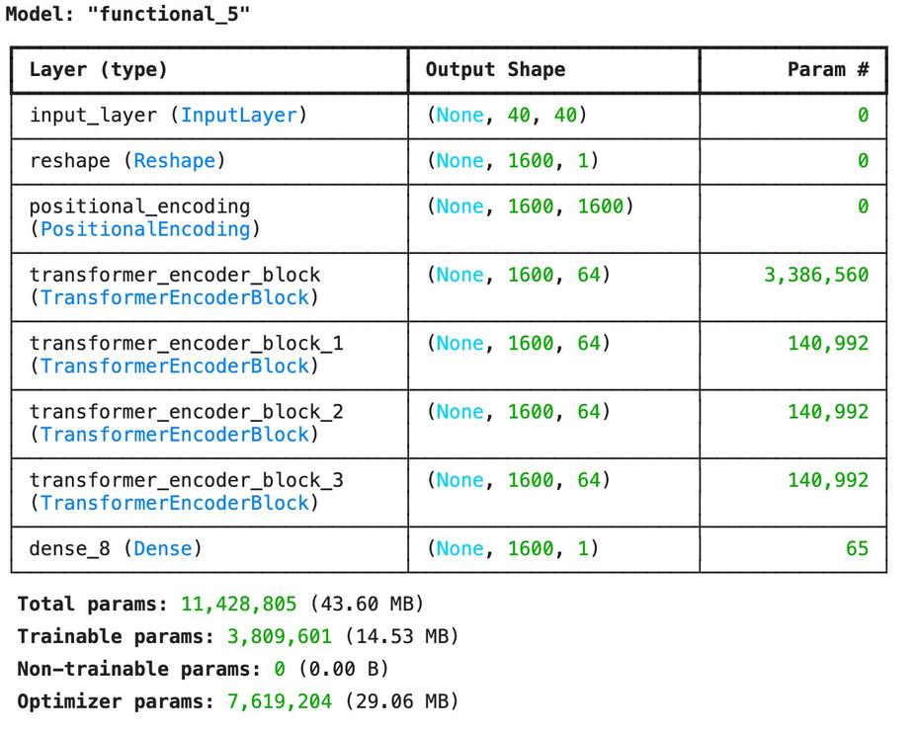
OUR MODEL
Inspired by MTR, and MGTR
Data Loading and Augmentation
Patch and Position Embeddings
Positional Encodings and Multi-Head Self Attention Layer
Training and Testing
SYED ALI HAIDER | HARSH TAMBI | SPRING 2024 | COMPUTER VISION
Notes:
The vision transformer model presented here draws inspiration from the methodologies employed in Motion Transformer (MTR) and Multi-Granular Transformer for Motion Prediction (MGTR). Similar to MTR, the model treats input images as sequences of patches, allowing it to capture spatial information effectively. Moreover, like MGTR, it incorporates positional encodings to provide spatial context to the model, enhancing its ability to understand the spatial relationships within the image. By leveraging self-attention mechanisms within the transformer encoder blocks, akin to both MTR and MGTR, the model can capture long-range dependencies and interactions between patches, enabling it to discern relevant features for predicting steering angles. Thus, this vision transformer model combines the strengths of both MTR and MGTR, blending transformer-based architectures with traditional convolutional neural networks, to create a robust framework for processing image data and generating continuous output predictions, such as steering angles of a self driving car.
Due to resource constraints of the Waymo Open Dataset as its size is about 1 TB long, we were not really successful with applying our model on it to compare it with State of the Art techniques like MTR, and MGTR. However, we then decided to apply our model to the dataset used in the Dave 2 approach to see how our algorithm performed.
Now, here’s a video of how our model performs on a simulation video, where the model takes the image from the video frame by frame and then predicts the steering angle.

Slide 11


DEMO
SYED ALI HAIDER | HARSH TAMBI | SPRING 2024 | COMPUTER VISION

Slide 12
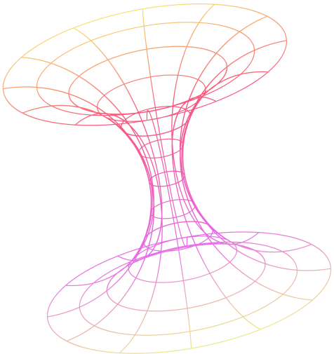
EVALUATION
DAVE 2:
98 % Accuracy
OUR MODEL:
95.5 % Accuracy
SYED ALI HAIDER | HARSH TAMBI | SPRING 2024 | COMPUTER VISION

Slide 13
FUTURE WORK
A. Increase the dataset (possibily Waymo)
B. More Epochs
C. Reinforcement Learning
D. Test this model on real-life road videos with more agents like in the Waymo Dataset.
SYED ALI HAIDER | HARSH TAMBI | SPRING 2024 | COMPUTER VISION

Slide 14
THANK YOU!
Q & A
SYED ALI HAIDER | HARSH TAMBI | SPRING 2024 | COMPUTER VISION

